Slide 1

Unit 9

Slide 2
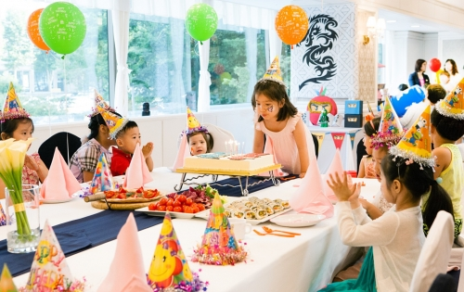
Unit 9
Can you come to my party?

Slide 3



Slide 4



To read an invitation
To learn to write a reply to an invitation
To learn some words and expressions:
opening, concert, headmaster, event, guest, calendar, daytime
The opening will be on the morning of Wednesday…
Please reply in writing to this invitation by Friday, December 20th.

Slide 5

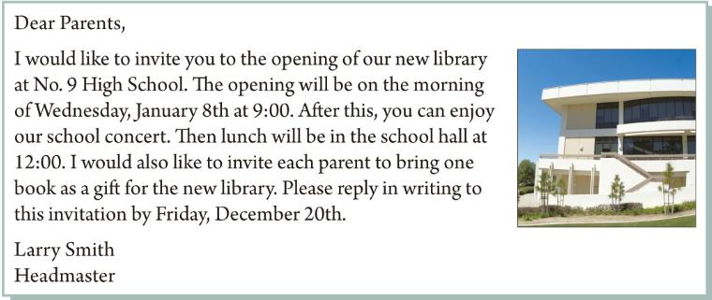
Here is an invitation. Read it and get some important information.
地点
时间
活动

Slide 6

on the morning of Wednesday, January 8th at 9:00
Time:
Place:
Activities:
at No. 9 High School
attend the opening of our new library,
enjoy our school concert, have lunch

Slide 7

Read again and answer the questions.
1. Who is making the invitation?
2. What is the invitation for?
3. When will the event happen?
Mr. Smith, the headmaster is making the invitation.
It’s for the opening of the new library.
It will happen on Wednesday, January 8th at 9:00.

Slide 8
4. What will happen after this?
5. Do parents have to bring anything?
After this, parents can enjoy the school concert and have lunch in the school hall at 12:00.
They have to bring one book as a gift for the new library.
6. How should people reply to this invitation, and when?
They should reply to this invitation in writing by Friday, December 20th.

Slide 9


Write an invitation to a party or any other event.
Include the following information:
kind of party or event
when and where it will be
if guests should bring anything
if guests should reply to the invitation
when and how guests should reply
Use the following words and phrases:
would like to
will be
after this
please
reply

Slide 10

邀请函
在日常生活中我们通常用口头或电话方式邀请别人来做客，但是如果遇到比较正式的场合，例如商业聚会、正式晚餐或婚礼等场合，就需要我们发送正式的书面邀请函。

Slide 11
无论举行什么样的正式聚会，在书写邀请函时应注意包含以下几点：
1. Names of party hosts or sponsoring organization
聚会主人或主办单位
2. Type of the event (birthday party, wedding party, etc.)
聚会活动
3. Place 地点
6. RSVP date and phone number 回复日期及联系电话
7. Any special dress requirements 聚会着装要求
4. Date 日期
5. Time 时间

Slide 12
邀请函的回复
无论收到哪种邀请信都要复信，明确表示接受与否。而且无论接受与否都要对邀请者表示感谢。
接受邀请的回信一般包含以下内容：首先感谢对方的邀请，并重述邀请信中的主要内容; 然后愉快地表示接受邀请，并简要说明自己的打算; 最后表示期待赴会和与对方见面的心情。

Slide 13
谢绝邀请的回信一般包含以下几方面的内容：首先对对方的邀请表示感谢; 然后具体说明自己无法接受邀请的原因，并对无法出席表示遗憾; 最后表达自己的祝愿，即祝愿自己未能参加的会议或者活动能够顺利进行。
谢绝邀请的句型:
Thanks so much for …
I’d love to …but I’m not available…

Slide 14
【写作任务】
假如你是李华，你刚刚搬了新家，为了庆祝乔迁之喜，你准备举办一个派对，你想邀请你的好友Karen来参加，请给她发一封邮件邀请她参加。
【思路点拨】
体裁：应用文(邀请函)
时态：一般现在时和一般将来时
人称：第一人称和第二人称

Slide 15
【头脑风暴】
To whom | Karen
For what | Housewarming party
When (date and time) | …
Where (place) | …
Other information | roles to play, things to bring or clothes to wear
Ask for reply | …

Slide 16
【提供素材】
◆句型
发出邀请：
I would like to invite you to my housewarming party.
Can / Will you come to my housewarming party?
Please join us for a housewarming party to celebrate our new home.
Join us for some drinks at our new house.
We are happy to invite you to join us for a housewarming party.
Relax in our new great room and dance.

Slide 17
聚会活动：
Please bring ... You don’t need to bring ...
We will / are going to ... We can ...
邀请回复：
Please reply to me by Monday.
Please let me know if you can come to the party.
表达诚意：
Hope you can make it.
I do hope you can make it.
I look forward to meeting you.

Slide 18

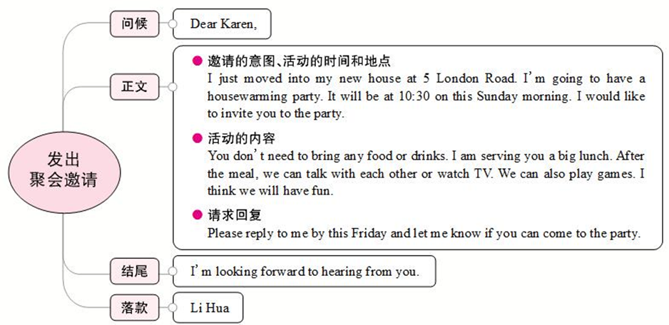

Slide 19

Dear Karen,
I just moved into my new house at 5 London Road. I'm going to have a housewarming party there. It will be at 10:30 on this Sunday morning. I would like to invite you to the party.
You don't need to bring any food or drinks. I am serving you a big lunch. After the meal, we can talk with each other or watch TV. We can also play games. I think we will have fun.
Please reply to me by this Friday to let me know if you can come to the party.
I look forward to hearing from you.
Li Hua

Slide 20



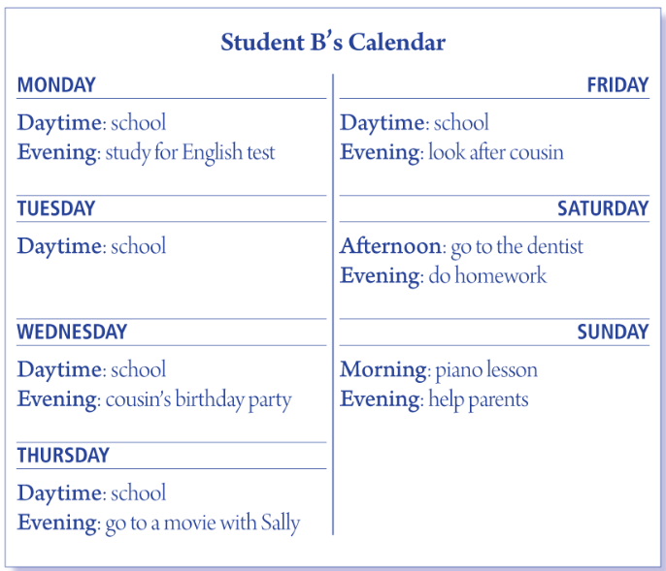
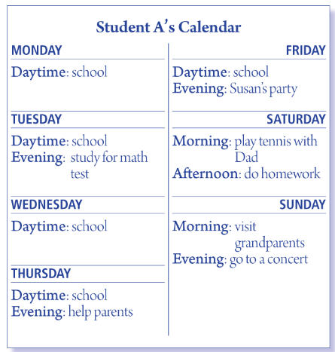
Student A, look at your calendar on the right. Student B, look at yours on page 81. Find a time when you can both go shopping.
They can both go shopping on Sunday afternoon.

Slide 21

Can you go shopping with me next week?
Sure. I’d love to. When?
I must study for the English test. What about Tuesday evening?
Well, what are you going to do on Monday evening?

Slide 22


1. Fill in the blanks in the conversation.
A: Hi, Peter. ______ you come to my party _____ the weekend?
B: Sure, ______ love to.
A: How about ______, Jenny?
C: I’m afraid I _____. I ______ to look after my little cousin.
A: _____ you come, Jeff?
D: I ______ be able to, but I’m not sure. _____ let you know tomorrow.
Can
on
I’d
you
can’t
have
Can
might
I’ll

Slide 23
2. You get these invitations but can’t go. Write a refusal and a reason.
1. Invitation: “Can you come to my party on Saturday?”
Reply: _______________________________________
2. Invitation: “Let’s go to the movies tomorrow night.”
Reply: _______________________________________
3. Invitation: “Let’s go to the concert on the weekend.”
Reply: _______________________________________

Slide 24
4. Invitation: “Do you want to go shopping with me next week?”
Reply: ________________________________________
5. Invitation: “Can you play soccer with me after school today?”
Reply: ________________________________________

Slide 25


根据短文内容，从方框中选择恰当的词语填空，有的需要变换形式。
sad, invite, until, take a trip, available, reply, look forward to
Emily is an English girl. It will be her fifteenth birthday the day after tomorrow. She is going to have a birthday party at her house that evening. Now she (1) _____________ some of her closest friends to her party by WeChat. She (2) ______________ having fun with them at the party.
is inviting
looks forward to

Slide 26
sad, invite, until, take a trip, available, reply, look forward to
replies
But Mary (3)________ that she can't come because she has to stay at home and do her homework. She won't finish it (4)________ 10:30 p.m. Luke can't come, either. He must go to the dentist (牙医) after school. Linda is not (5)________. Her parents will (6)_________ to New York. They need to do some shopping. So Linda has to stay at home to look after her little sister. Paul would like to come, but he has to meet his friend from Canada that evening. Emily feels (7)_________ about that. Everyone is busy! Finally, Emily decides to spend her fifteenth birthday with her family.
until
available
take a trip
sad

Slide 27


According to the invitation in 3b, write a reply to your partner’s invitation. If you turn down the invitation, give a good reason.

Slide 28


